Slide 1

IOT on Blockchain
IoT and Blockchain Platform to Manage Assets/Resources between Trustless Parties

Slide 2
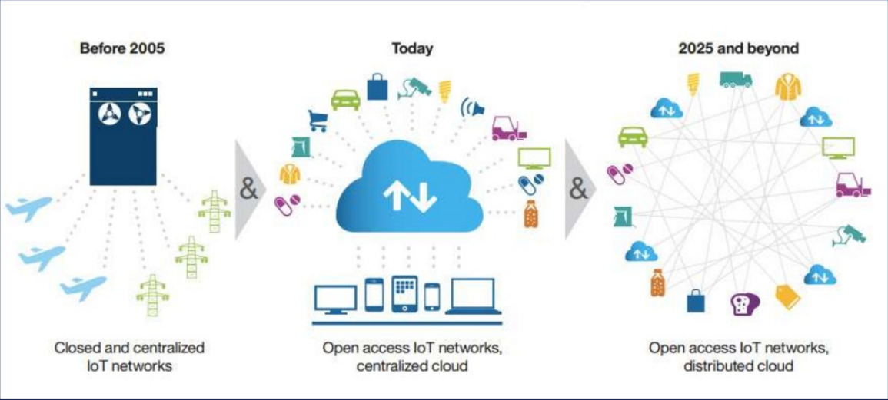
From “trusted” human centralized authorities to trustless, decentralized networks
Source : http://www.slideshare.net/eteigland/bitcoin-not-just-a-currency-but-an-iot-facilitator
Notes:
Content Slide: This is usually the most frequently used slide in every presentation.
Use this slide for Text heavy slides. Text can only be used in bullet points
Title Heading – font size 30, Arial Heading
Slide Content – Should not reduce beyond Arial body font 16
If you need to use sub bullets please use the indent buttons located next to the bullets buttons in the tool bar and this will automatically provide you with the second, third, fourth & fifth level bullet styles and font sizes
Please note you can also press the tab key to create the different levels of bulleted content

Slide 3
Blockchain Internet of Things
Smart Energy Business Opportunities & Usecases

Slide 4
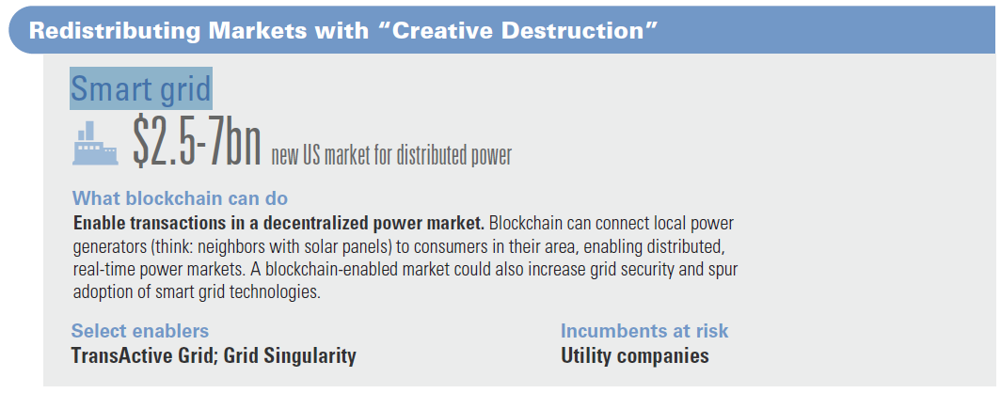
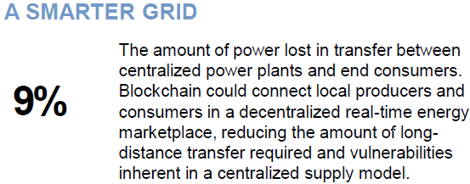
Smart Grids – leveraging Blockchain IOT
Smart Grid – A New Market for Disruptive Power enabled by Blockchain IOT
Source : Goldman Sachs report Blockchain Putting Theory into Practice
Notes:
Content Slide: This is usually the most frequently used slide in every presentation.
Use this slide for Text heavy slides. Text can only be used in bullet points
Title Heading – font size 30, Arial Heading
Slide Content – Should not reduce beyond Arial body font 16
If you need to use sub bullets please use the indent buttons located next to the bullets buttons in the tool bar and this will automatically provide you with the second, third, fourth & fifth level bullet styles and font sizes
Please note you can also press the tab key to create the different levels of bulleted content

Slide 5
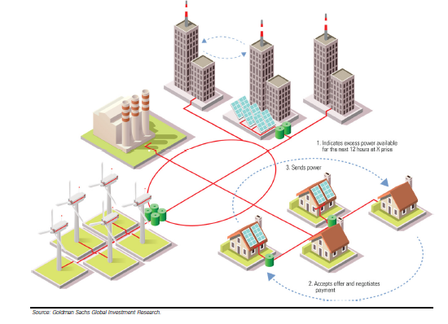
Combining blockchain with the Internet of Things could enable the negotiation of distributed power transactions IN
Blockchain combined with IOT technology can provide a highly decentralized energy marketplace
Community Micro-grid : A new peer-to-peer power market enabled by Blockchain & IOT technologies
Source : Goldman Sachs report Blockchain Putting Theory into Practice
Notes:
Content Slide: This is usually the most frequently used slide in every presentation.
Use this slide for Text heavy slides. Text can only be used in bullet points
Title Heading – font size 30, Arial Heading
Slide Content – Should not reduce beyond Arial body font 16
If you need to use sub bullets please use the indent buttons located next to the bullets buttons in the tool bar and this will automatically provide you with the second, third, fourth & fifth level bullet styles and font sizes
Please note you can also press the tab key to create the different levels of bulleted content

Slide 6
Blockchain IOT Smart Grids – In Future…
In the coming future, the Internet of Things (IoT) will enable billions of smart devices which would sense, respond, communicate and share data. Blockchain technology along with IOT devices will help to organize, coordinate and secure a true peer-to-peer power grid
Electricity consumers and producers within a community will be connected through wireless or wired networks in a mesh topology
IoT based sensors will relay from each node, information regarding energy produced and consumed along the network
A “smart metering” of energy can be activated using a blockchain
Blockchain would enable a real-time visualization of energy demand and supply
Smart contracts will orchestrate business processes to coordinate and close energy purchase agreements/negotiations across energy peers
In future, blockchain enabled provenance would renew the trust between end consumers and energy suppliers by allowing consumers to know where their energy comes from
Notes:
Content Slide: This is usually the most frequently used slide in every presentation.
Use this slide for Text heavy slides. Text can only be used in bullet points
Title Heading – font size 30, Arial Heading
Slide Content – Should not reduce beyond Arial body font 16
If you need to use sub bullets please use the indent buttons located next to the bullets buttons in the tool bar and this will automatically provide you with the second, third, fourth & fifth level bullet styles and font sizes
Please note you can also press the tab key to create the different levels of bulleted content

Slide 7
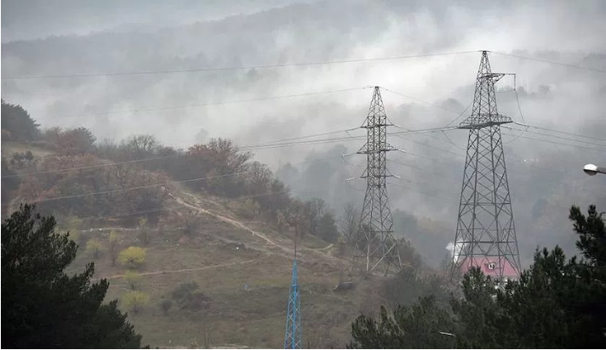
Blockchain IOT – Reinventing existing Power Grids
Power poles can be made smart things using IOT
Each pole can publish and report its state on a blockchain
If a pole should catch fire or begin to tip/fall, it would generate an incident report in real time and blockchain event generation would notify a repair crew to prompt quick fixing
A mesh network of smart devices can be reconfigured using blockchain smart contracts to adjust for bandwidth/capacity/outage, thereby resisting any power supply interruption
In some parts of the world it takes more than a day to identify, reach and fix a pole that snapped off from the grid!
Notes:
Content Slide: This is usually the most frequently used slide in every presentation.
Use this slide for Text heavy slides. Text can only be used in bullet points
Title Heading – font size 30, Arial Heading
Slide Content – Should not reduce beyond Arial body font 16
If you need to use sub bullets please use the indent buttons located next to the bullets buttons in the tool bar and this will automatically provide you with the second, third, fourth & fifth level bullet styles and font sizes
Please note you can also press the tab key to create the different levels of bulleted content

Slide 8
Sample Usecase : Energy Supply/Consumption Reconciliation
In UK, there are many Electricity Generation companies who supply to the Grid and there are many Distribution Companies who Distribute Electricity to the end consumers. They get into commercial agreements.
The electricity supply and consumption is in real time and will not be balanced according to the predetermined agreement between these Generation and Distribution companies.
This requires a reconciliation process which sometimes take 6 months for the commercial settlement.
IoT devices can be installed by the Generation and Distribution companies on the Grid which record their data on the Blockchain.
The Smart Contracts on the Blockchain automate the reconciliation and settlement process.

Slide 9
More Usecases
https://www2.deloitte.com/uk/en/pages/energy-and-resources/articles/blockchain-applications-in-energy-trading.html
https://www.navigantresearch.com/research/blockchain-enabled-distributed-energy-trading

Slide 10
Blockchain Internet of Things
Solution Approach, Architecture, Design and Technologies

Slide 11
Characteristics of Usecases where our PoC Solution can Fit
Disintermediation
Multiple parties who do not trust each other, requiring an intermediary to provide the trust, execute the agreement/business logic agreed upon by the parties to manage/control the assets.
Blockchain will disintermediate and autonomously execute the smart contracts which will manage the resources(like electricity, water)etc using the IoT sensors and control devices.
Reconciliation
Multiple parties who share assets or resources based on some agreement. But requiring a lot of time and effort in reconciliation and settlement.
Blockchain Smart contracts provide reconciliation “on the go” using the sensor data from the IoT devices.
Immutable record of real world events
To keep a public record of real world events which is immutable and cannot be destroyed.
Blockchain provides the peer-to-peer network which can provide immutability of the records which cannot be destroyed. The record lives on the Blockchain on all peer nodes. Helps regulators to audit the records. Acts as an immutable Blackbox of the history of events.

Slide 12
Building Blocks in our PoC Solution
IoT Devices
A bunch of real world assets or resources which need to be managed/controlled. These assets are fitted with appropriate sensors and control devices. These devices may belong to the various stakeholders.
Blockchain Network, Shared Ledger and the Smart Contract
The stakeholders participate as peer nodes on the Blockchain network.
The Blockchain Shared Ledger is the consensus database living on each of these peer nodes.
The Smart Contract is the codified agreement between the stakeholders (i.e. the business logic) which can execute autonomously on each of the peer nodes upon receiving the external messages from IoT devices.
Smart Contracts receive the sensor data from the IoT devices, store them, process them and generate the commands to the control devices.
HiveMQ – Publish/Subscribe Broker
Enables two way asynchronous Publish/Subscribe communication between the IoT Devices and the Blockchain nodes.

Slide 13



IOT sensors integrated with Ethereum Blockchain to – sense, record data, generate events and trigger action on threshold conditions
Node 2
Node 3
User Interface Screens
Ledger Data
- Smart Sensor(s) data
- Transaction data
Node 1
Integration API
(Ethereum Web3 Interface)
Node n…
MQTT Protocol
Smart Contracts
- Record IOT Sensor Data
- Generate Events
- Trigger action based on
some pre-defined condition
IOT Device Sensor(s)
Ethereum Console
Ethereum Smart Contract Blockchain Platform
Interoperability

Slide 14
Solution Architecture
Hive MQTT Broker
(Publish/Subscriber)
IoT Device
MCU (ESP8266-12)+ MQTT client Library
Topic/SensorData
MQTT
Sensors
Topic/ControlData
MQTT
Temp
Humidity
Light Intensity
MQTT
MQTT
Device Under Control
MQTT
LED
MQTT
Blockchain – Node1
Blockchain – Node2
Node JS + MQTT library
Blockchain Shared Ledger &
Smart Contracts on all Nodes
Node JS + MQTT library
Admin/Controller Role
Observer Role
Web-Socket
Web3
Web3
Web-Socket
Web - based Admin Dashboard
Web - based Dashboard

Slide 15
PoC Design
Our IoT device has three sensors namely Temperature, Humidity and Lux (Light intensity)sensor.
IoT device publishes the sensor data to the HiveMQ Publish/Subscribe Broker using MQTT Protocol(Topic published: SensorData)
The Blockchain node has subscribed to the HiveMQ Publish/Subscribe Broker.(Topic Subscribed: SensorData)
The Blockchain node posts the SensorData to the Smartcontract through the web3 library call.(web3 is the library call to interface with the blockchain network).
Smart contract saves the sensor data, processes and generates the control command. The control command is asynchronously received by the Blockchain node.

Slide 16
PoC Design
Blockchain node publishes the control command to the HiveMQ Publish/Subscribe Broker using MQTT Protocol(Topic published: ControlData).
IoT device has subscribed to the HiveMQ Publish/Subscribe Broker.(Topic Subscribed: ControlData)
IoT device controls the device as per the command. In our PoC we are using an LED as the device under control. The LED will be switched ON/OFF.

Slide 17
Technologies Used
Ethereum Blockchain:
Geth – Ethereum Client
Solidity Language to write Ethereum Smart Contract
Solc Compiler to compile Smart Contract into EVM (Ethereum Virtual Machine)byte code.
Web3 Javascript library to interface with the Ethereum blockchain.
Blockchain Node Application
Nodejs
Websocket
JavaScript
MQTT Library for Nodejs
HiveMQ – MQTT Publish/Subscribe Broker
HiveMQ – MQTT Client

Slide 18
Technologies Used
IoT Device
MCU ESP8266-12
MQTT Client Library
Temperature/Humidity, Light Sensors
LED

Slide 19
Blockchain Internet of Things
PoC Solution Demo Screen Shots

Slide 20
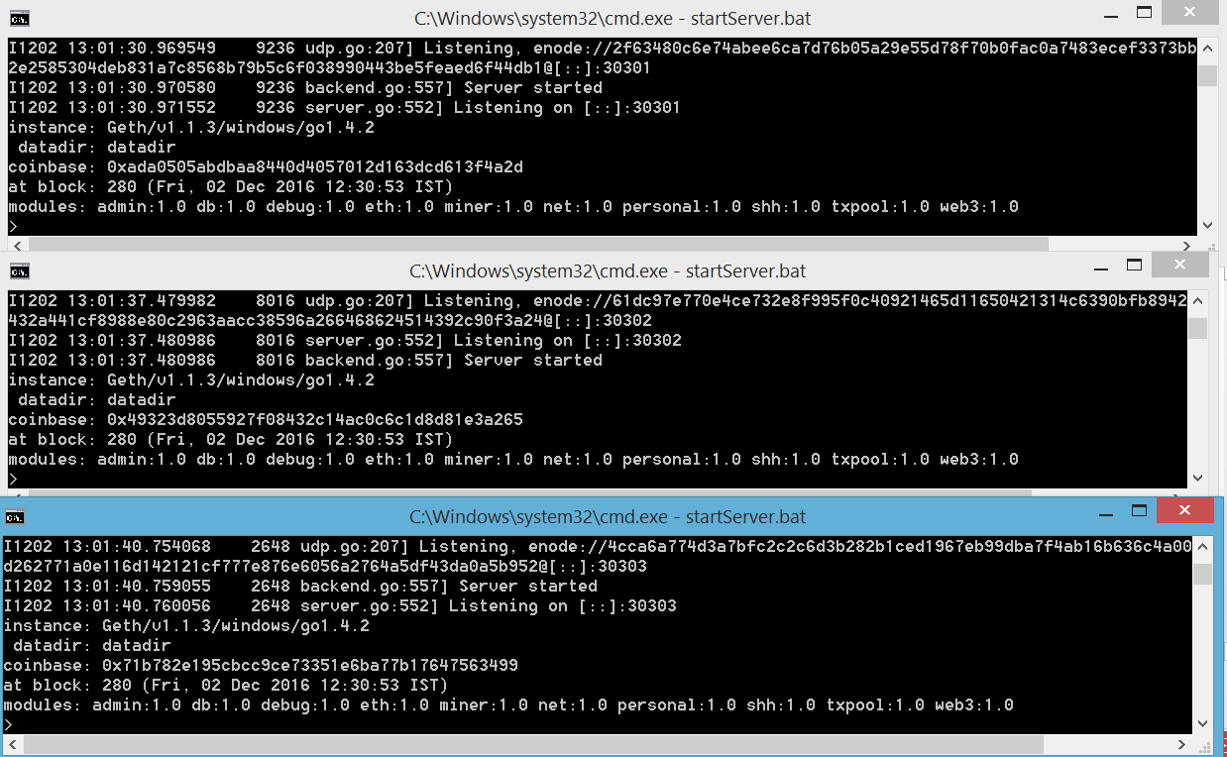
Starting Ethereum with 3 peer nodes
Ethereum Geth running on Node 1, Private Network ID 123, Port 30301
Ethereum Geth running on Node 2, Private Network ID 123, Port 30302
Ethereum Geth running on Node 3, Private Network ID 123, Port 30303

Slide 21
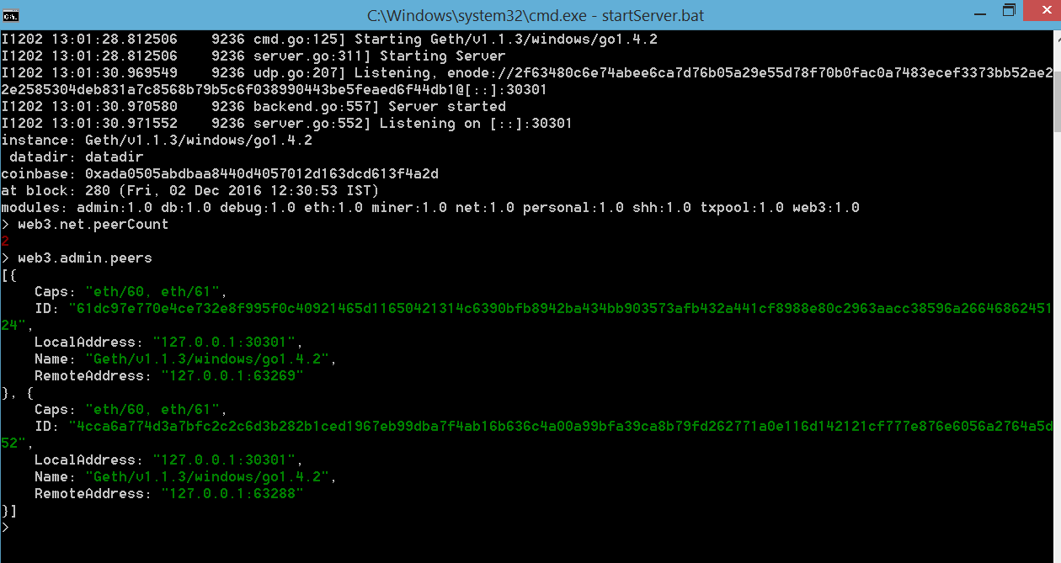
A private Ethereum chain running with 3 peer nodes
2 Peer Nodes to Node 1 - > Node 2 and Node 3
Details of 2 Peer Nodes to Node 1

Slide 22
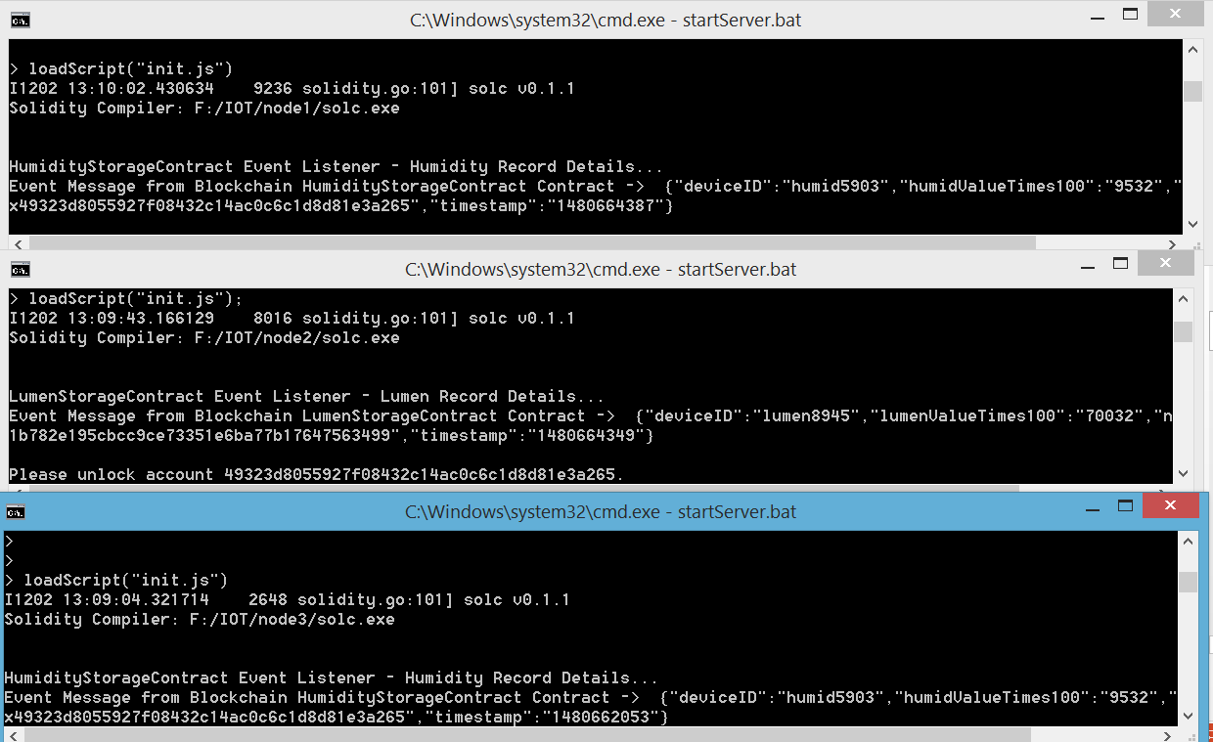
Executing initialization scripts on Ethereum Console
Initialization scripts executed in Node 1 console to:
Load Smart Contract ABI definition
JS utility scripts to invoke Smart Contract
JS utility scripts to persist and query Blockchain
- Start Blockchain Event Listeners
Initialization scripts executed in Node 2 console to:
Load Smart Contract ABI definition
JS utility scripts to invoke Smart Contract
JS utility scripts to persist and query Blockchain
- Start Blockchain Event Listeners
Initialization scripts executed in Node 3 console to:
Load Smart Contract ABI definition
JS utility scripts to invoke Smart Contract
JS utility scripts to persist and query Blockchain
Start Blockchain Event Listeners
Start as Mining Node

Slide 23
Recording Temperature Data in Blockchain

Slide 24
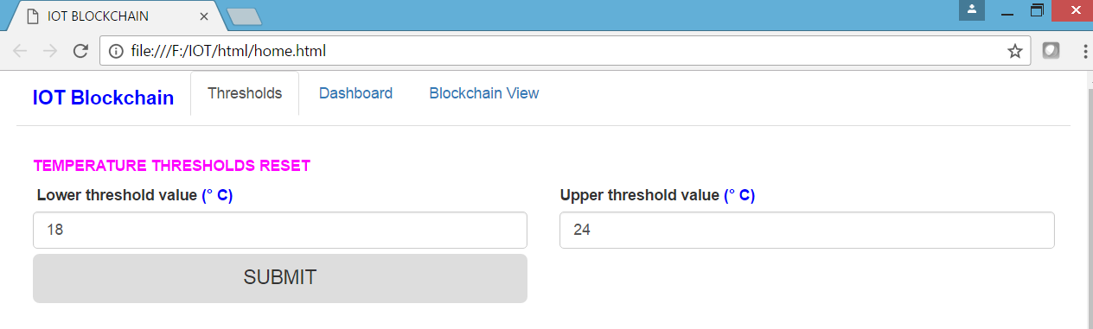
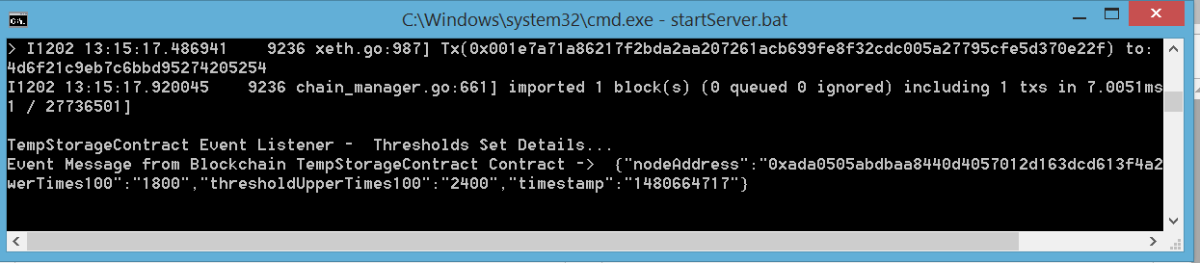
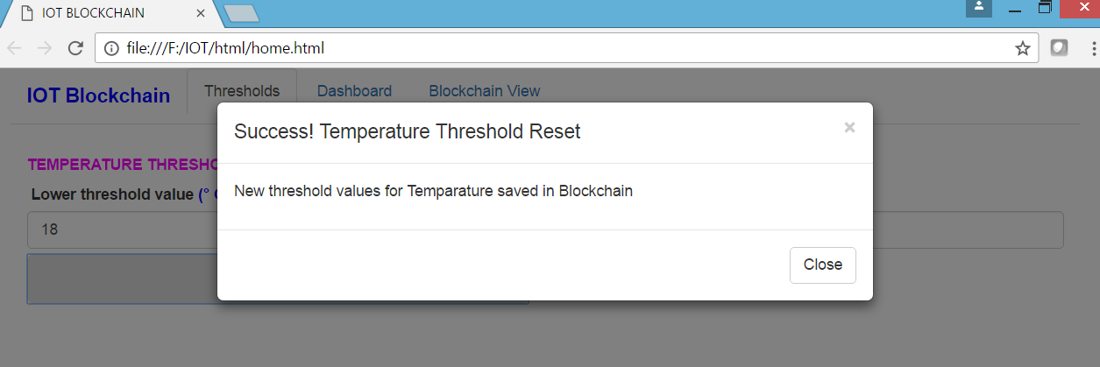
Temperature Thresholds Reset
Set Temperature Thresholds from UI
Transaction posted to Blockchain and Event response on Console after storing temperature threshold data in Blockchain (after Mining)
Event response on UI after storing temperature threshold data in Blockchain (after Mining)

Slide 25
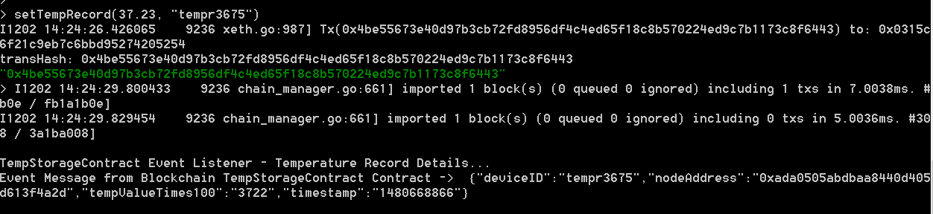
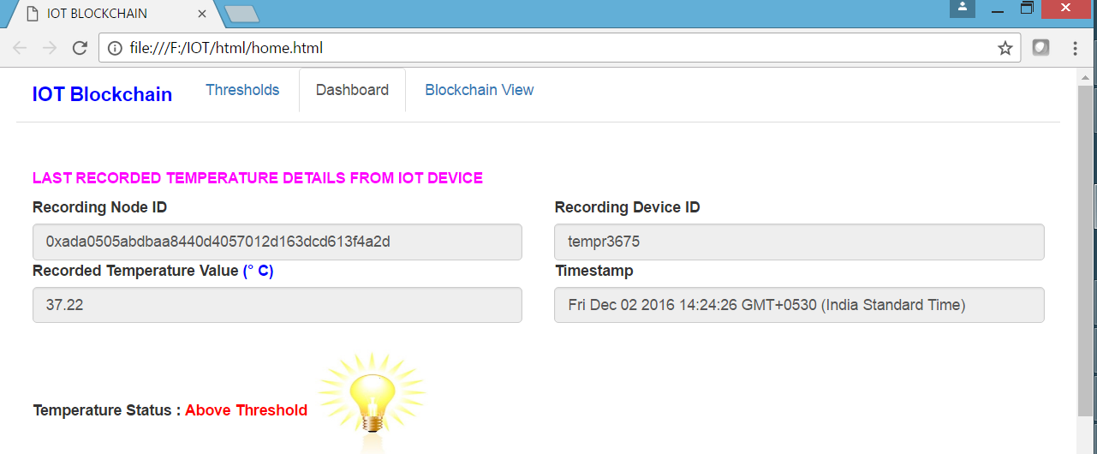
Recording Temperature Data in Blockchain
Store Temperature Record on Blockchain (with temperature value and device ID as inputs). This will be posted from actual device through Ethereum web3 API during IOT integration
Transaction posted to Blockchain and Event response on Console after storing temperature record data in Blockchain (after Mining)
Event response on UI dashboard after storing temperature record data in Blockchain (after Mining)

Slide 26
Recording Humidity Data in Blockchain

Slide 27
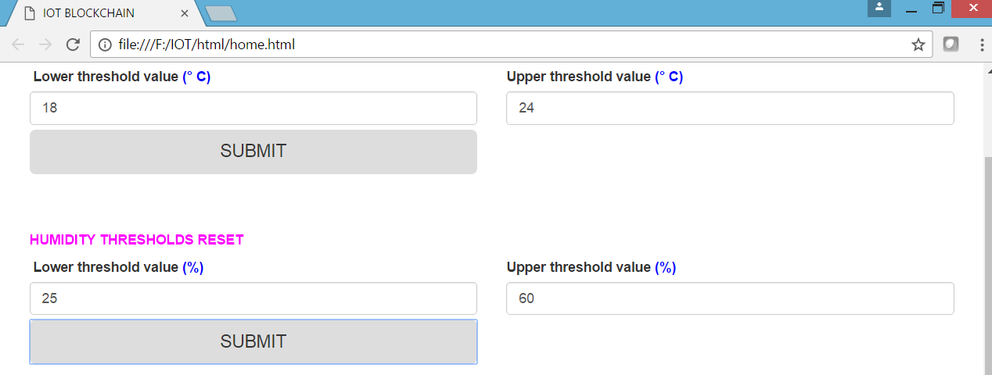
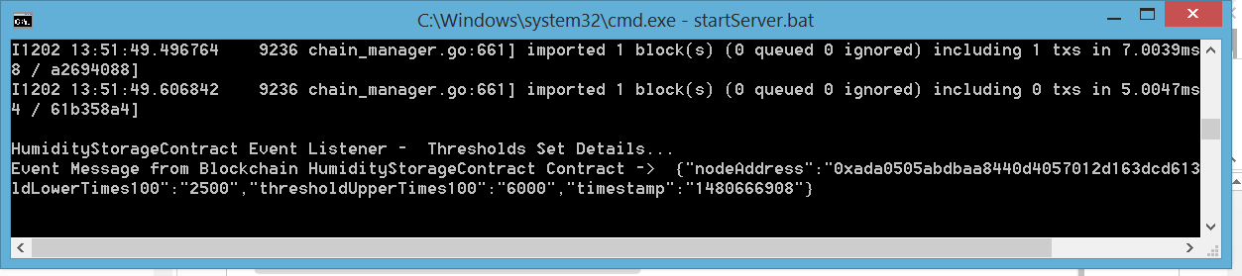
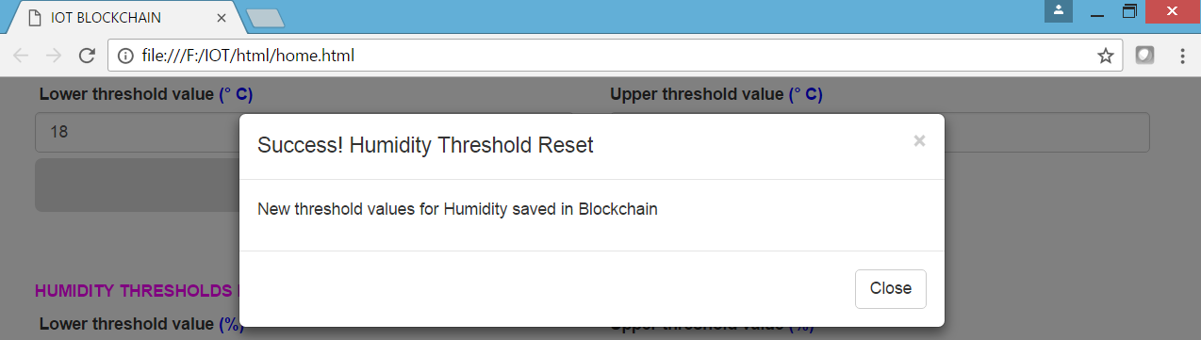
Humidity Thresholds Reset
Set Humidity Thresholds from UI
Transaction posted to Blockchain and Event response on Console after storing humidity threshold data in Blockchain (after Mining)
Event response on UI after storing humidity threshold data in Blockchain (after Mining)

Slide 28
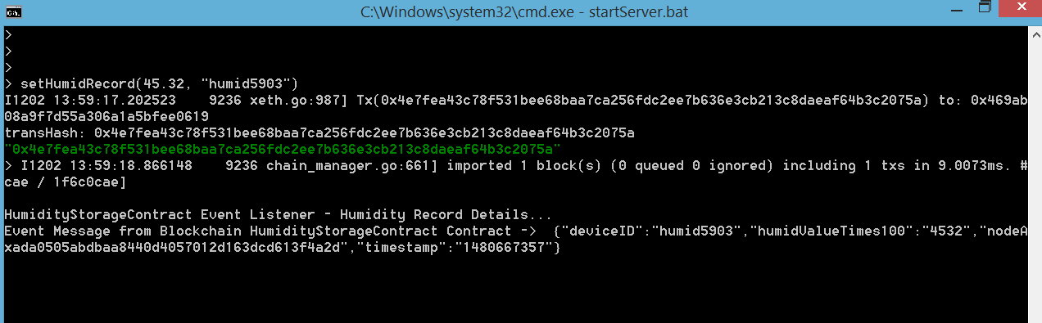
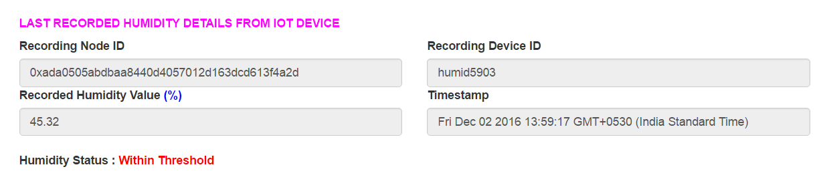
Recording Humidity Data in Blockchain
Store Humidity Record on Blockchain ( with humidity value and device ID as inputs). This will be posted from actual device through Ethereum web3 API during IOT integration
Transaction posted to Blockchain and Event response on Console after storing humidity record data in Blockchain (after Mining)
Event response on UI dashboard after storing humidity record data in Blockchain (after Mining)

Slide 29
Recording Luminance Data in Blockchain

Slide 30
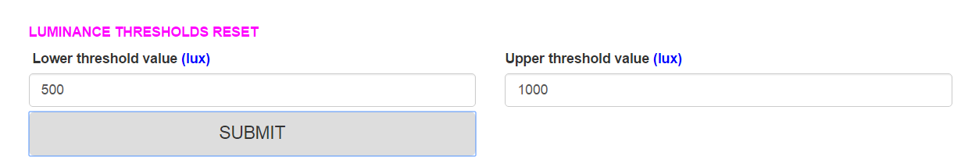
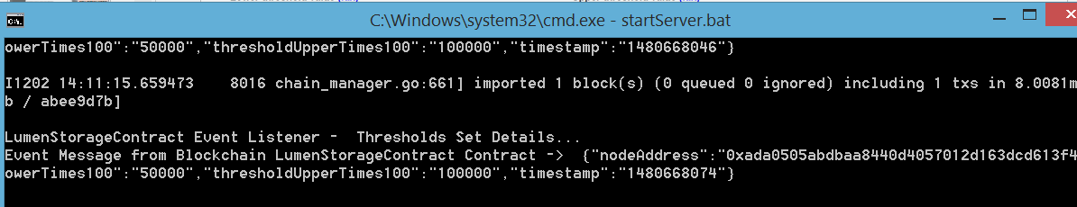
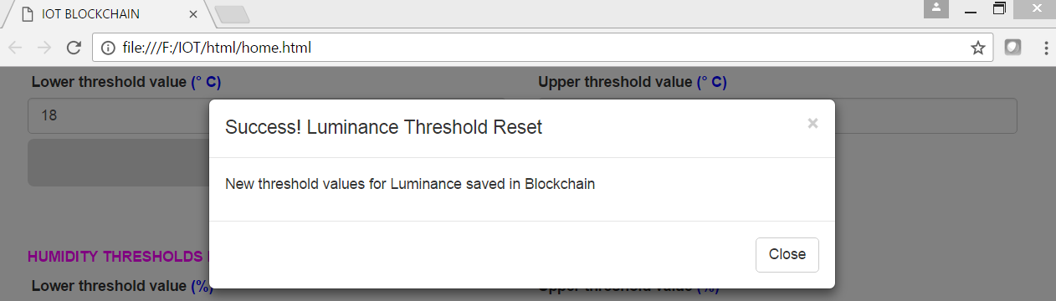
Luminance Thresholds Reset
Set Luminance Thresholds from UI
Transaction posted to Blockchain and Event response on Console after storing luminance threshold data in Blockchain (after Mining)
Event response on UI after storing luminance threshold data in Blockchain (after Mining)

Slide 31
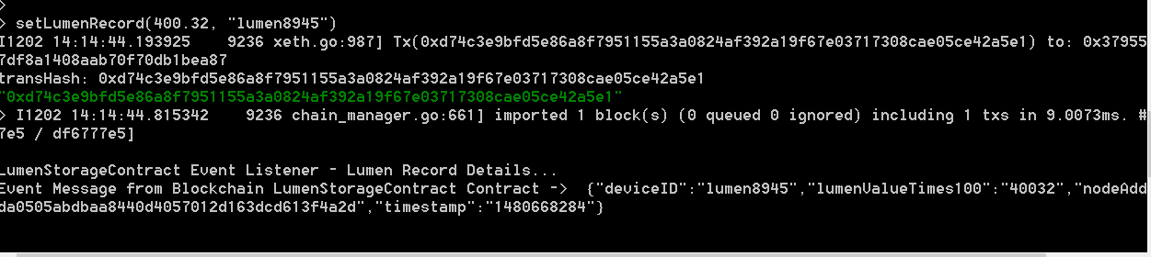
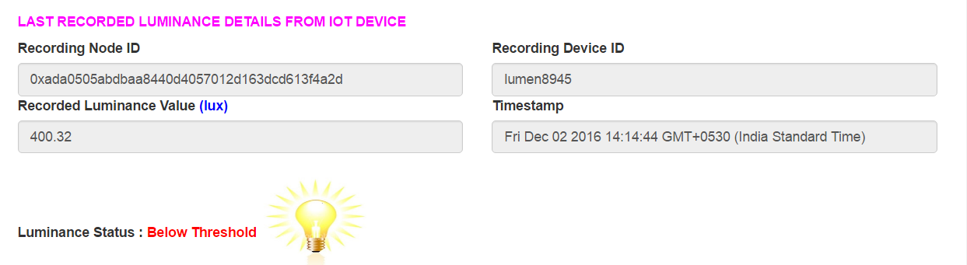
Recording Luminance Data in Blockchain
Store Luminance Record on Blockchain ( with humidity value and device ID as inputs). This will be posted from actual device through Ethereum web3 API during IOT integration
Transaction posted to Blockchain and Event response on Console after storing luminance record data in Blockchain (after Mining)
Event response on UI dashboard after storing luminance record data in Blockchain (after Mining)

Slide 32
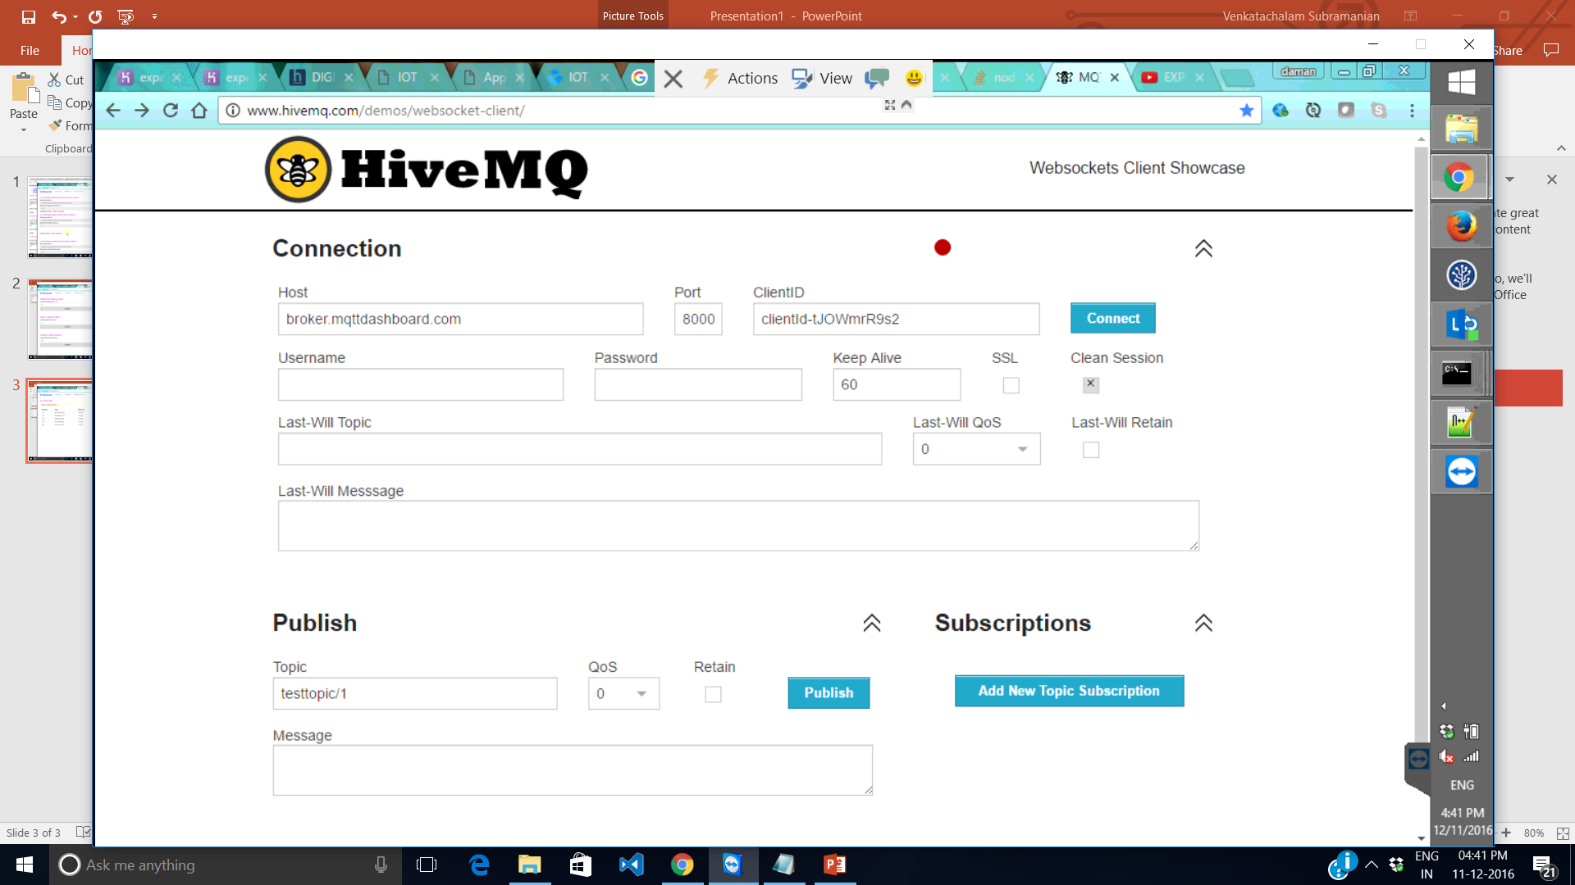

Slide 33
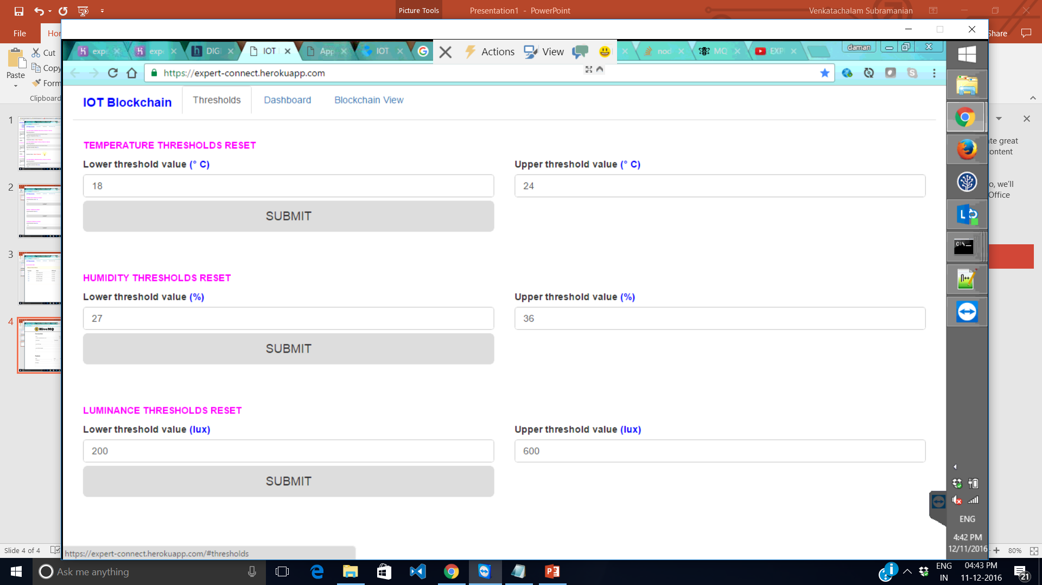

Slide 34
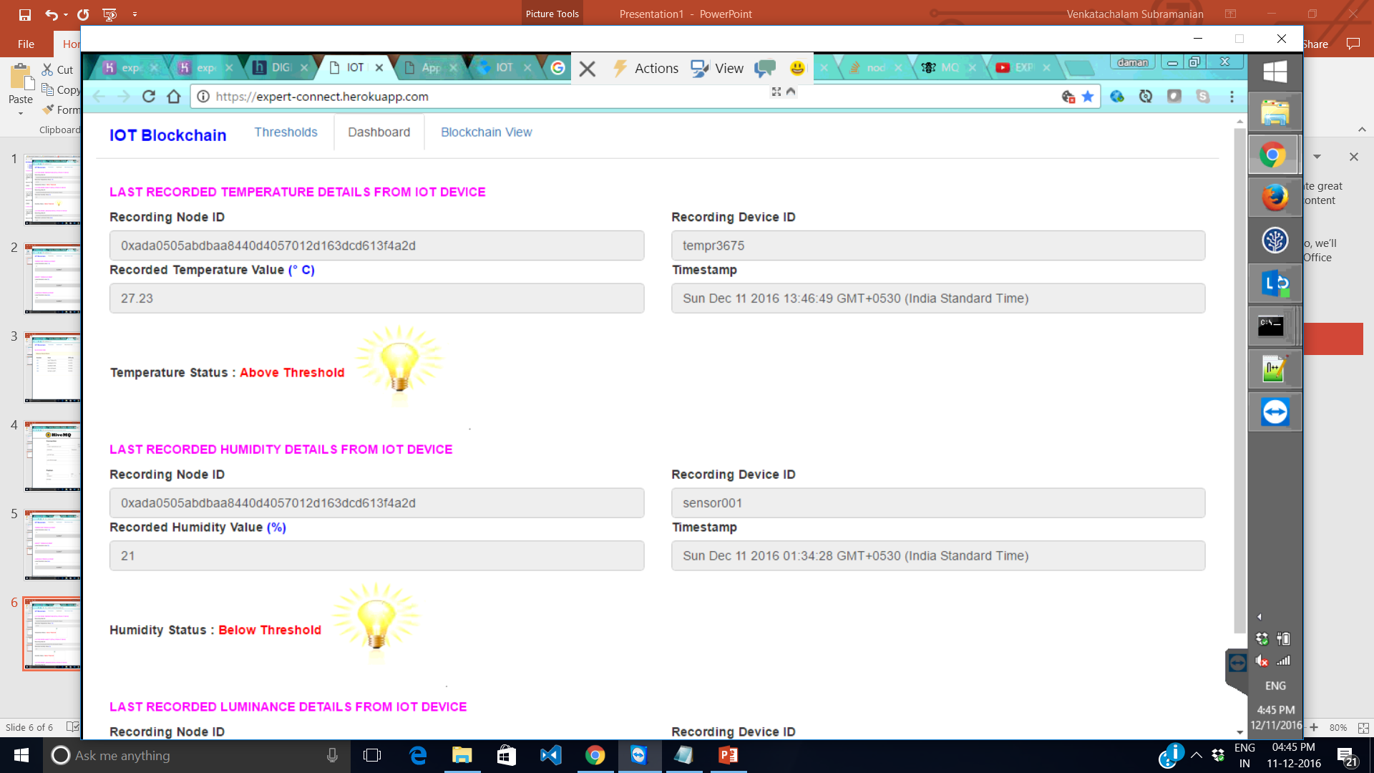

Slide 35
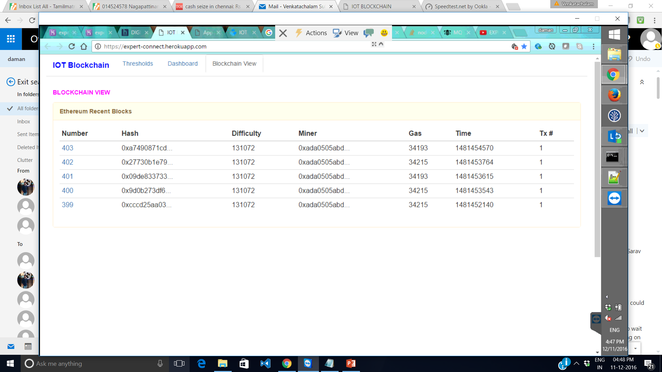

Slide 36




ExpertConnect Team
Sriram Rajagopalan
CTO Office
Sumanta Basu
COMMS - North America, Vodafone Account
Sarav Daman
Product Engineering Services, HP Account
Venkatachalam Subramanian
Talent Transformation

Slide 37
Thank You!

